Slide 1
Fake News Detection
Using Deep Learning
Group Members:
Ringki Borgayary (202002031011) (ECE)
Pallabi Boro (202002031016) (ECE)
Urbasi Kochary (202002031020) (ECE)
Chanta Devi Brahma (202002031021) (ECE)
Fake News Detection

Slide 2
Contents
Introduction
Problem Statement
Block Diagram
Objective
Literature Survey/Related Works
System Architecture
References
Fake News Detection

Slide 3
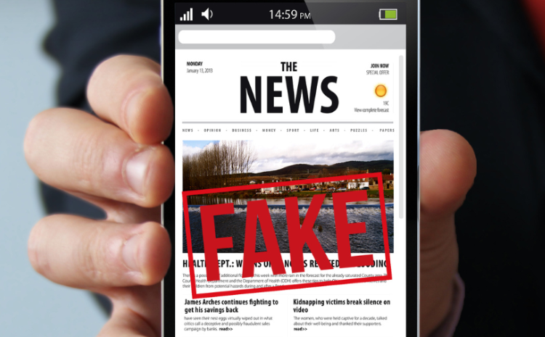
Introduction
Nowadays, informations are travelling faster with the rise
of social media.
Many of them contains mal-information that leaves negative impact in society.
In today’s world, detecting a fake news is becoming increasingly difficult.
Fake News Detection

Slide 4
Problem Statement
Social media allows low cost, simple access and fast dissemination of information to its users.
There are very few options to check the authenticity of the information that is circulated.
There is a need for a web-based platform that uses ML to provide us with that
opportunity.
Fake News Detection

Slide 5
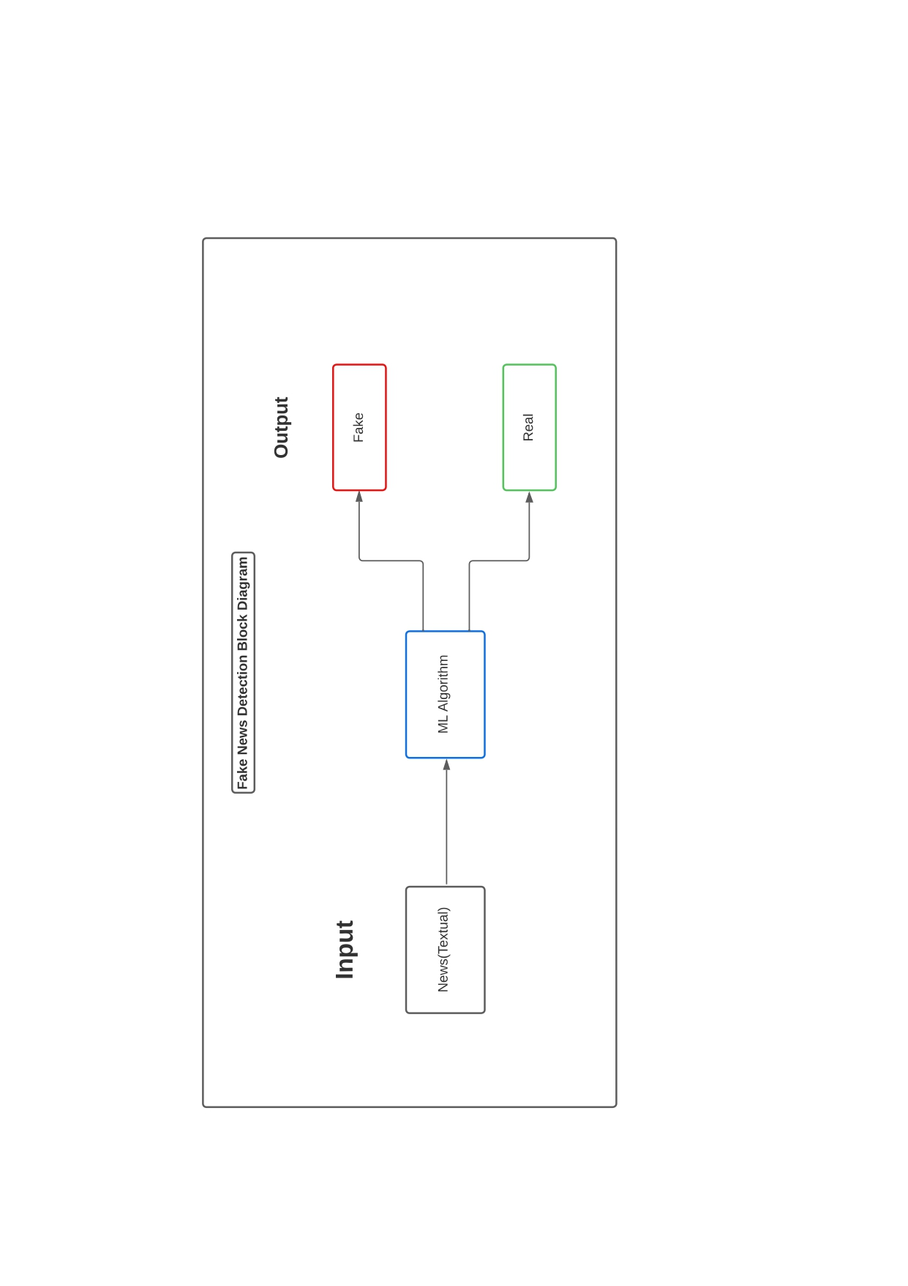
Block Diagram
Fake News Detection

Slide 6
Objectives
The primary objective of this proposed work is to detect fake news to ensure the creditability, benefits of the real news by using Deep Learning.
It will be able to classify real and fake news, which is a classic text classification problem with a straightforward proposition.
Fake News Detection

Slide 7
Literature Survey / Related Works
Sl. No. | Paper Title | Author | Methodology | Accuracy
1. | “The Pope Has a New Baby!” Fake News Detection Using Deep Learning | Md. Lutfor Rahman Rafe, Mashiat Nahreen, Rabiul Alam Abir | It uses Logistic Regression, Two-layer Feedforward Neural Network, RNN, LSTM, Gated Recurrent Units, Bidirectional RNN with LSTMs, CNN with Max Pooling, Attention-Augmented CNN | 93%
2. | FAKE NEWS DETECTION USING NLP | N S S RAMA CHANDRA, S SANDEEP, B V KISHORE | A model based on a K-Means clustering algorithm.It contains a Word2Vec model. | 87%
Fake News Detection

Slide 8
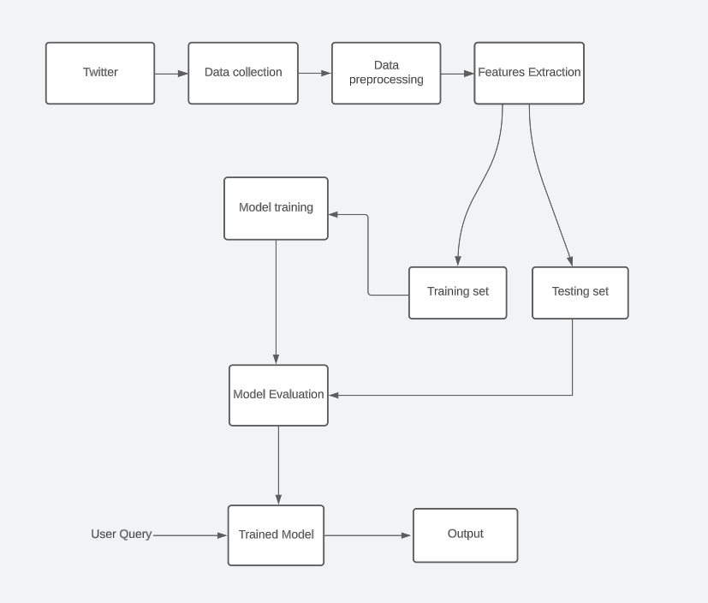
System Architecture
Fake News Detection

Slide 9
References
Fake News Detector _ Final Project Report _ (154429, 160041026, 160041028) by ISLAMIC UNIVERSITY OF TECHNOLOGY (IUT)https://shorturl.at/rGX04
“The Pope Has a New Baby!” Fake News Detection Using Deep Learning by Samir Bajaj(Stanford University)https://web.stanford.edu/class/archive/cs/cs224n/cs224n.1174/reports/2710385.pdf
FAKE NEWS DETECTION USING NLP by ANITS https://cse.anits.edu.in/projects/projects2021C5.pdf
Fake News Detection

